Slide 1
Trauma Informed Approach
Pennsylvania Prison Chaplains Association Conference
September 17, 2019
Lynn A. Patrone
Forensic Mental Health Advocate

Slide 2
Performance Objectives
Define trauma
Describe effects and reaction to traumatic events
Understand the risk factors for suicide and trauma
Understand the principles of a trauma informed approach
Define the resilient factors of trauma

Slide 3
How We Think….
Affects How We Respond
Notes:
Our intentional mind is similar to a small person riding an elephant. Why?
How we were raised impacts how we respond
Life experiences impact how we respond
Key is to change how we respond
If we think a person is dangerous then reacting by force seems to make sense B/C this is how we think
If we think a person may be afraid/desperate we will typically respond from a place of safety

Slide 4
 | Brain takes in information and determine if the threat is valid.
 | Brain now recognizes that there is no longer danger.
 | You are interacting with an individual and he /she becomes very agitated or threatening. He/she accuses you of not listening or helping.
 | Brain initiates the fight, flight or freeze response.
 | Brain sends a message that there is an emotional or physical threat which sets off a warning.
 | Response is informing the individual that you will not communicate with them or sending them away.
 | Rational/thoughts are taken over by the emotional brain.

Slide 5
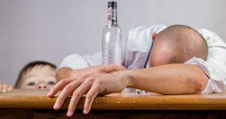
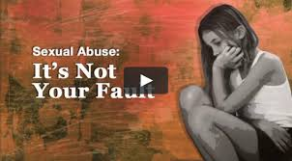
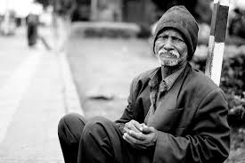
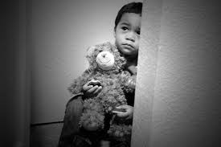
Let’s Talk About
The Who?????
Notes:
Females are more at risk of sexual trauma
Men are most likely to be exposed to stressful events, physical assault and violence
Military/veterans
GLBT (gay, lesbian, bisexual, transsexual)
Individuals living with mental illness
Intellectual/developmental disabilities
Elderly
Communities
Military personnel

Slide 6
Who Experiences Trauma
11 to 20 percent of veterans who served in Operations Iraqi Freedom or Enduring Freedom and about 12 percent of veterans who served in the Gulf War have PTSD in a given year;
23 percent of female veterans who use VA health care services report having experienced sexual assault while in the military.
How Common is PTSD? National Center for
PTSD, U.S. Department of Veterans Affairs,2015

Slide 7
Characteristics of Trauma
Single event
Recurring event(s)
Continual exposure
Mental illness/substance use
Processing (cascading trauma)
Loss
Support
Notes:
Single-recovery period may not be prolonged
Recurring/repeated-cumulative effect over time
Was act intentional?
For some people trying to identify all of the pieces of the traumatic event can impede the recovery process.
Loss-For some people the losses may have more of an impact than the event

Slide 8
Bureau of Justice Statistics
State incarceration and Mental Illness (MI)
2x more likely to have been homeless within 1 year before their arrest;
County custody and MI
2 x more likely to report physical or sexual abuse in their past.
Notes:
1 in 2 women experience partner violence
1 in 5 men
90-95% females experienced a trauma in their lifetime & 74% within the year of arrest & about 80-90 for men
AND ¾ have recurring trauma
So we should be operating from a universal precaution
Bureau of Justice Statistics Special Report, Mental Health Problems of Prison and Jail Inmates, Doris J. James and
Lauren E. Glaze BJS Statisticians, September 2006, NCJ 213600

Slide 9
MacArthur Mental Health Court Study
70% women & 25% men report sexual abuse/rape before age 20;
46% women & 27% men saw parents act violent toward each other;
61% women & 68% men beat by parents;
67% women & 73% men physical abuse;
34% women & 32% men experienced physical or sexual abuse within the past 12 months.
https://www.youtube.com/watch?v=K_WL5iqvPlY
Notes:
Callahan, Steadman, Vessenlinov, under review

Slide 10
Trauma and Culture
Certain populations may experience higher rates of trauma;
Culture influence how an event is perceived and the response;
May disrupt the culture;
May impact access to support.
Notes:
Culture influences are extremely important in understanding an individual’s trauma. It’s imperative that culture be considered in our approach as certain traumatic experiences may have a profound impact culturally. Eg-asain culture and shame.
The positive benefit is that certain cultures such as Native American may see a traumatic event as retribution.
May determine the response and whether an individual seeks help or other resources.
Discuss Native Americans-generations of colonization, discrimination, poverty, forced assimilation and LOSS
Very high rates of suicide
911 and continued exposure

Slide 11
Trauma Informed Approach
Realizes the widespread impact of trauma and understands potential paths for recovery;
Recognizes the signs and symptoms of trauma in clients, families, staff, and others involved with the system;
Responds by integrating knowledge about trauma into policies, procedures, and practices; and
Resist re-traumatization.

Slide 12
SAMHSA’s Six Key Principles
Safety
Trustworthiness and Transparency
Peer support
Collaboration and mutuality
Empowerment, voice and choice
Cultural, Historical, and Gender Issues
Notes:
The effects of traumatic events place a heavy burden on individuals, families, systems and communities.
Many people who experience a traumatic event will go on with their lives without lasting negative effects.
Others will have difficulties and experience traumatic stress reactions.
If there is a strong support system in place, little or no prior traumatic experiences, and if the individual has many resilient qualities, it may not affect his or her mental health.

Slide 13
What Defines a Trauma
3E’s-Event(s) Experience Effects
An overwhelming event or series of events experienced by an individual
Not the event alone that impacts the person but the experience and the response
Can be physically, emotionally and psychologically harmful
May cause fear, helplessness, vulnerability or terror
Notes:
Sustained trauma-children who are abused, people in violent relationships, people in chronically stressful relationships. Could be a person that lived in chronic poverty.
Not the event alone that impacts the person but the experience and the response- means 2 people can experience a very similar traumatic event but different factors such as cultural factors influence the impact of the trauma.

Slide 14
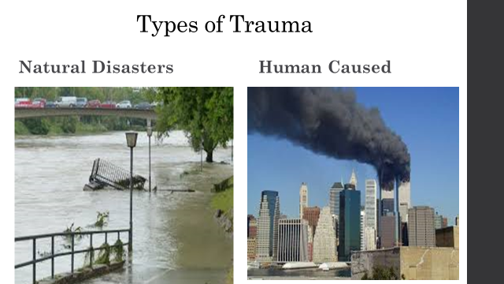
Various Types
Notes:
How a person experiences trauma can impact the level of shame and guilt
Show NPR clip

Slide 15
Notes:
Individual trauma-may feel causation, shame

Slide 16
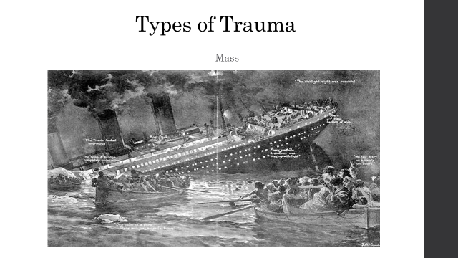

Slide 17
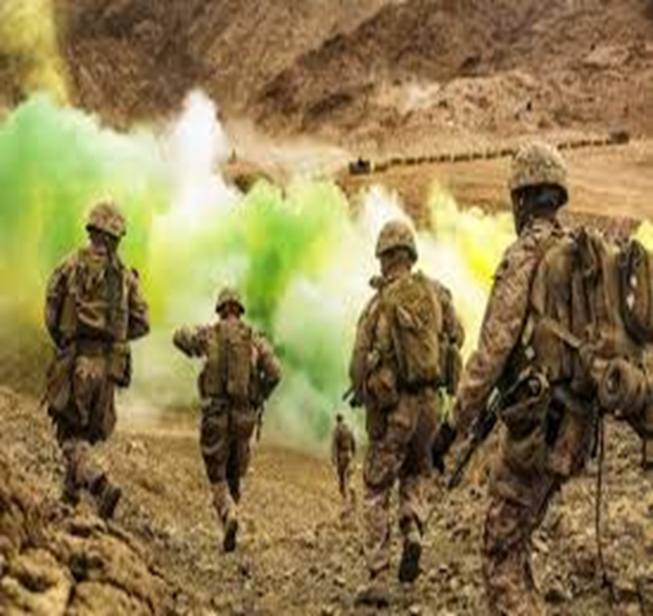
Political/War Trauma

Slide 19
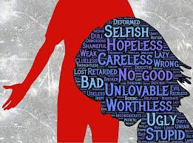
Adverse Childhood Experiences (ACES)
Occur within a certain period of development
Influence later development
Physical
Mental
Emotional
Neglect
Physical
Emotional
Sexual
Impacts adulthood
Risk for recurring trauma exposure
Notes:
1 in 4 experienced child abuse or neglect in past year. 5x higher in lower socioeconomic households
Trauma in younger people can affect the developmental processes, attachment, emotional regulation, life assumptions, and cognitive interpretations of later experiences.
Study by the CDC of 17k children that analyzed long term effects of childhood and youth and impact on life and life expectancy
Childhood abuse is highly associated with depression, suicide, PTSD and dissociative symptoms, substance use
Childhood trauma isn’t something that you just get over. Affects brain development.
Early intervention may be foster care which may further traumatize the child.
For most people, the body’s emergency response shuts down
shortly after danger has passed.
􀀁􀀁
But in childre􀀃n e􀀂xposed to severe or chronic trauma, the
emergency response system can get stuck in the “on” position.
􀀁􀀁
The stress h􀀃orm􀀂ones keep flowing and make it harder for
the parts of the brain that think and plan to work efficiently.
The stress hormones and related brain chemicals that are
generated actually get in the way of rational thinking.
When the people who should be protecting, loving, and guiding
young children expose them to trauma instead of care, children’s
development can get derailed.
A brain that is constantly reacting to threats can become “wired”
for survival in a risky and unpredictable world—developing in a way
that:
􀀁􀀁
Keeps the ch􀀃ild􀀂 on constant alert for danger
􀀁􀀁
Allows the ch􀀃ild􀀂 to respond quickly to even the slightest threat
When this happens, other developmental pathways get disrupted,
and children may fail to accomplish other important “developmental
tasks.”

Slide 20
Children are not mini adults

Slide 21
Effects of Trauma
Early traumatic events such as abuse, neglect and other forms of trauma can:
Result in biological/psychological changes and stress responses;
Increase a person’s vulnerability to encountering interpersonal violence as an adult;
Overwhelms the ability to utilize cognitive, emotional, physical and positive coping skills
Notes:
Can affect brain development
Changes in brain function-impacts serotonin

Slide 22
Trauma Resistance | Trauma Informed Approach
Lazy/unmotivated
Manipulative/always looking to get something
Disrespectful
Antagonistic
Seeking attention
Uncaring/lacks empathy

Slide 23
Biological Impact of Trauma
Let’s look at 3 areas of the brain impacted by trauma
Amygdala
Pre-frontal cortex
Hippocampus
Notes:
Changes in the amygdala which is part of the limbic system which is responsible for emotions and drives;
Experience of a traumatic event can be imprinted on the amygdala which impacts emotions
Amygdala stores the images of trauma as sensory fragments, which means the trauma memory is not stored like a story, but by how senses experienced the trauma at the time it was occurring. The memories are stored through fragments of visual images, smells, sounds, tastes, or touch. This can lead to being easily triggered and perceived threat can be present.
Pre-frontal cortex-rational part of our brain where consciousness decisions are made, processing and reasoning occur. So when trauma occurs or perceived threats the organization of processing shuts down and brain may go into flight fight or freeze as a stress response.
Hippocampus-helps us retain memories and when traumatized it may not be able to differentiate between past and present events and may cause the person to react to a threat or perceived threat,.

Slide 24
Physiological Impact
Changes in the limbic system
Nerves in the brain that drive mood and emotions such as fear, pleasure, anger.
Hyperarousal
Increase risk of developing chronic diseases/other physical illnesses, mental illnesses/substance-related disorders
Notes:
The response to these emotions which may be dominance, caretaking, sex drive.
Hyperarousal can be beneficial and detrimental-can cause undue fear and anxiety, sleep issues, over-react
If we’re functioning well, stress produces rapid and pronounced hormonal response; however, chronic and persistent stress inhibits healthy response
PTSD can follow exposure to events that are intensely distressing.

Slide 25
Physical effects
Somatic complaints
Sleep disturbances
Gastrointestinal
Cardiovascular
Musculoskeletal
Respiratory
Dermatological
Urological problems
Substance abuse disorders
STDs
Notes:
Somatic-relating to the body-person may perseverate on the physical symptoms solely complaining of physical ailments even in the absence of medical confirmation of an illness or ailment. They become emotionally detached as a means of avoidance. This can be a sign of a mental illness.
RHU can trigger traumatic event such as feeling powerless, anger, being locked in etc.
Authority is often an issue. Incarceration takes away autonomy, control and choice creating constant triggers.
Some may think they dealt with the trauma and may have.
It is important to rule out medical conditions however.

Slide 26
Psychological Effects
Depression
Suicide
Anxiety
Panic attacks
Nightmares, flashbacks, sleep issues
Isolation

Slide 27
Psychological Responses to Trauma
Responses
Fight/flight response
Confusion
Dissociation/blunted affect
Acute Stress Disorder (ASD)
Prolonged experiences of distress, lack of feeling calm, intrusive thoughts
Nearly 1/3 of survivors experience symptoms that interfere with lives after several weeks and lasts from 2 days up to a month
Post Traumatic Stress Disorder
More than a month
Untreated ASD may lead to PTSD
Notes:
Feel powerless
Responses can be very complicated and affected by person’s experiences-what is most important is the coping effects.
Symptoms may present for a period then recede
Those who present more psychiatric symptoms (depression and anxiety) may be misdiagnosed and therefore untreated. For many the symptoms are obscured by substance use.
PTSD usually begins within 3 months of the event in adulthood but can be delayed for months or years.
May experience minimal symptoms initially but then experience a crisis later and experience which trigger PTSD symptoms.
Can be repeated exposure-Katrina Hurricane replayed on tv.
Subthreshold trauma related symptoms-symptoms don’t meet the PTSD or ASD diagnostic criteria but cause limitations in functioning. May occur occasionally then recede.
Acute Stress Disorder – Experienced by about a third of survivors. Symptoms begin within four weeks and can last up to a month and interfere in some way with that person’s life.
PTSD – when acute stress disorder continues on a more chronic course.
Over a life time-the chance of PTSD is 5% for men and 10% for women; of those, 50% recover by a year.
Only about 10% (SWAG estimate) of first responders going into towers ended up with PTSD
Reliving – victim relives trauma in dreams or intrusive flashbacks (or the opposite, can’t recall the event).
Anxiety – avoids anything connected with the trauma. Difficulty falling asleep. Can’t concentrate. Startles easily.
Numbness – becomes numb to life. Feels detached and estranged from people.
Thoughts of suicide – often these are acted on

Slide 28
BEHAVIOR = SURVIVAL
Notes:
Important to remember that our inmates have likely been exposed to personal and community violence
People may experience an event and recover with little to no emotional scars
More vulnerable people may experience more severe impact which can lead to risk of trauma
Behaviors may be pervasive-seemingly unrelated to a trauma
Coping mechanism
Trying to figure out how to avoid being hurt
The majority of people with behavioral health issues that are involved with the justice system have significant histories of trauma
Personality Disorders
May not connect reactions to certain events to a traumatic event

Slide 29
Behavioral Effects
Self injury-cutting, burning, punching, head banging, inserting objects, PICA
Substance use/self-medicating
Impulsive behavior
Overeating
Poor relationships
Avoidance/anxiety
Aggressiveness
May be learned from the event or be a result of the event
Notes:
Saying “no” to help
Resistance to authority
Withdrawal
Submissiveness to others
Gender differences in response to trauma

Slide 30
Cognitive Effects
Avoidance
Suspicion of others/constantly “on guard”
Feelings of helplessness
Cynical, accusatory/irritable
Can alter ability to reason, rationalize
Impacts the daily world/life around a person
Feeling different than other people
May believe that others could never understand
Shame, guilt
Triggers
Notes:
Avoidance is common but can lead to longer term anxiety. Initially it is helpful as the person may avoid places or people who hamed tehm but over time this anxiety may increase and can lead to perceiving situatons as dangerous when there is no validity to the danger. Can lead to emotional disconnection in relationships. This is b/c the person may not be able to tolerate strong emotions associated with a certain event.
Trauma stress usually results in 2 extremes-feeling too much or too little
Triggers may set feelings off-can be identified, but many are subtle and can catch the individual off guard such as:
Sensory: noise, smell, visual, or physical sensation
Cognitive Triad of Stress
Views abut world-dangerous place, people are untrustworthy
Views about self-I’m damaged, worthless, my fault
Views abut future-pessimism, things will never be the same, bad things will always happen to me
Guilt and shame are two of the most common and difficult emotions to be dealt with in healing.
Emotional pain can be uncontrollable
“Never” feel safe

Slide 31
Emotional Impact
Emotional Dysregulation-difficulty regulating their emotions
Occurs more often when trauma occurred at a young age
Usually short-lived in older survivors who were functioning well before the trauma
May experience shame, anxiety, sadness, guilt
Numbing-biological process
Emotions are detached from thoughts, behaviors and memories
Notes:
Occurs more when a trauma occurred at a young age
Survivors may have difficulty identifying feelings for various reasons, such as:
Lack of experience with emotional expression in their family or natural environment;
May associate strong feelings with past trauma;
Youth exposed to trauma often have difficulties regulating their emotions. They may
be aggressive and defensive or appear withdrawn and disconnected. These survival responses
can become so much a part of how a child operates in the world that it is difficult for adults to
identify behaviors as trauma-related responses. Without considering trauma, we run the risk of
misunderstanding and mislabeling the core issues our students may be facing.
May believe emotional expression is too dangerous; may fear it will lead to feeling out of control;
May deny that they have any feelings associated with their trauma.

Slide 32
Why do different people react differently to traumatic events?
RISKS
RESILIENCE
Health issues
Pre-existing MH problems
Severity of trauma
Proximity of trauma
Biology
Numerous traumas
Experiences that diminish coping capacity
Family ties
Strong primary relationship
Connection to community
Employment
Meaningful activity
Strong cultural or religious beliefs
Notes:
Children of traumatized parents are more vulnerable to traumatic events

Slide 33
Paradigm Transference
“What's wrong with me?”
Recognize the resilience
“What happened to me?”
Notes:
Reactions are a normal reaction to abnormal circumstances which may have fiormed during the developmental phase

Slide 34
Resilience
Can lead to evaluating one’s life/values
Increased connections to family/community
Redefine purpose or meaning
Re-establish priorities
Advocacy
Notes:
Efficacy=usefulness, effectiveness

Slide 35
“Secondary Trauma”
Trauma-related stress reactions/symptoms resulting from exposure to another individual’s traumatic experiences
Not from exposure directly to a traumatic event
Risk factors:
Anxiety/stress or mood disorders
Prior personal trauma
Substance use
Compassion fatigue/vicarious trauma/burnout
Lack of healthy coping skills
Notes:
Staff Wellness
Staff may have experienced trauma and are exposed to others who have experienced trauma on a daily basis.
Experiencing/seeing traumatic events can alter our feelings about ourselves, other people, and environment
Stress triggers the fight/flight. Regardless of what it is that causes you stress when you reach the maximum that only you can determine your body kicks in fight or flight.

Slide 36
“Secondary Trauma”
Are you noticing……
Depression, anxiety, somatic complaints, numbing substance use, disordered eating, avoidance
Vulnerability or feeling increased vulnerability
Cynicism
Helpless
Accusatory
Relationship troubles
Detachment
Countertransference
Being judgmental
Decrease in socialization
Loneliness
Change in personal fundamental principles
Disconnection from personal interests
Notes:
Staff Wellness
Staff may have experienced trauma and are exposed to others who have experienced trauma on a daily basis.
Experiencing/seeing traumatic events can alter our feelings about ourselves, other people, and environment
Stress triggers the fight/flight. Regardless of what it is that causes you stress when you reach the maximum that only you can determine your body kicks in fight or flight.

Slide 37
Components of Self Care
Preventing Secondary Trauma
Physical
Emotional
Spiritual
Psychological
Peer/social support
Consultation
Training
Counseling/psychotherapy
Balance

Slide 38
Quote to Ponder…
“Many abused children cling to the hope that growing up will bring escape and freedom.
But the personality formed in the environment of coercive control is not well adapted to adult life. The survivor is left with fundamental problems in basic trust, autonomy, and initiative. She approaches the task of early adulthood establishing independence and intimacy burdened by major impairments in self-care, in cognition and in memory, in identity, and in the capacity to form stable relationships.
She is still a prisoner of her childhood; attempting to create a new life, she reencounters the trauma.”
Judith Lewis Herman, Trauma and Recovery: The Aftermath of Violence - From Domestic Abuse to Political Terror

Slide 39
References
Blum,D.. (2002). Love at Goon Park: Harry Harlow and the science of affection. New York: Basic Books.
Herman, J. (1992). Trauma and recovery; the aftermath of violence – from domestic abuse to political terror. New York: Basic Books.
Nash, M. (10/13/2000). Medicine: Not So Dopey Dopamine. Time Magazine.
Van der Kolk, B. (2014). The body keeps the score: Brain, mind, and body in the healing of trauma, New York: Viking.
Van der Kolk, B., McFarlane, A. C., and Weisaeth, L. (1996). Traumatic stress: the effect of overwhelming experience on mind, body, and society. New York: Guilford Press.
Substance Abuse and Mental Health Services Administration, Trauma Informed Care in Behavioral Health Services. Treatment Improvement Protocol (TIP) Series 57. HHS Publication No. (SMA) 14-4816. Rockville, MD: Substance Abuse and Mental Health Services Administration 2014.
https://www.ncjfcj.org/sites/default/files/Finding%20Your%20ACE%20Score.pdf (ACES Quiz)
Understanding Trauma and Its Impact ActivityPacket-https://safesupportivelearning.ed.gov/sites/default/files/Trauma_101_Activity_Packet.pdf.

