Slide 1

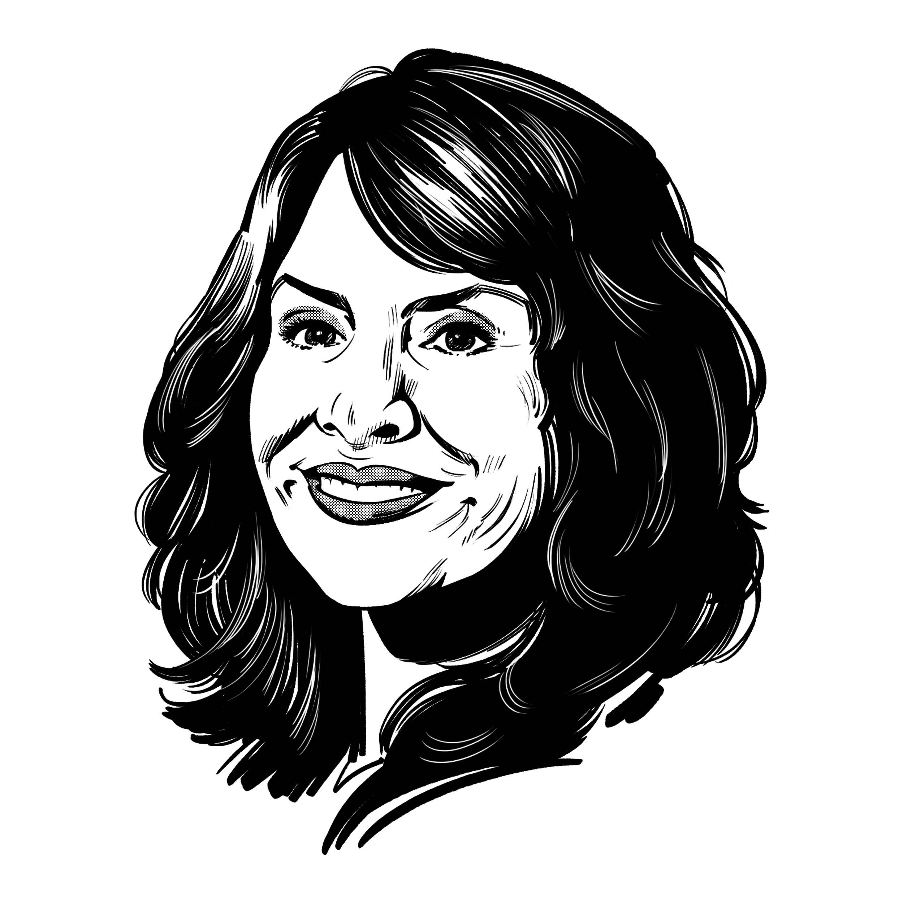
PA
Chaplains
Conference
Kristi Miller Anderson, PhD

Slide 2
Do you have a seat at the table?
Is your voice heard among corrections leaders?
Where do I
Fit In?
My Journey (and disclaimers)
Your Journey
We are the People of Purpose and Hope

Slide 3
The Importance of
Self Care
First, A look
Within
“Man Know Thyself.”
Socrates, when asked to reduce all philosophical commands,
circa 440BC
“Our wisdom, in so far as it ought to be deemed true and solid Wisdom, consists almost entirely of two parts: the knowledge of God and the of ourselves.”
John Calvin, Institutes of the Christian Religion, 1536

Slide 4




Correctional Staff Wellness:
A Look Within
Overview
Of
Sessions
Correctional Staff Wellness:
A Chaplain’s Role
Desistance Theory: Chaplain as Gateway for Community Prosocial Influences
Desistance Theory: Chaplain as Coach for Prosocial Behaviors / Attitudes

Slide 5


Slide 27


Slide 29
How has your prison chaplaincy job changed you? Reflect on the positives and negatives.
Reflection
What is your attitude toward self-care?
Do you see it as a personal weakness, or a humble acceptance of your own humanity?
What interventions do you need to put into practice to help/prevent burnout?
Fill me up, so that I may overflow on to others love, grace, and mercy.
Recognizing the stages of burnout in others should help build empathy.

Slide 30

Thank you!
kristimilleranderson@gmail.com
225.439.0019
Kristi Miller Anderson, PhD

