Slide 1
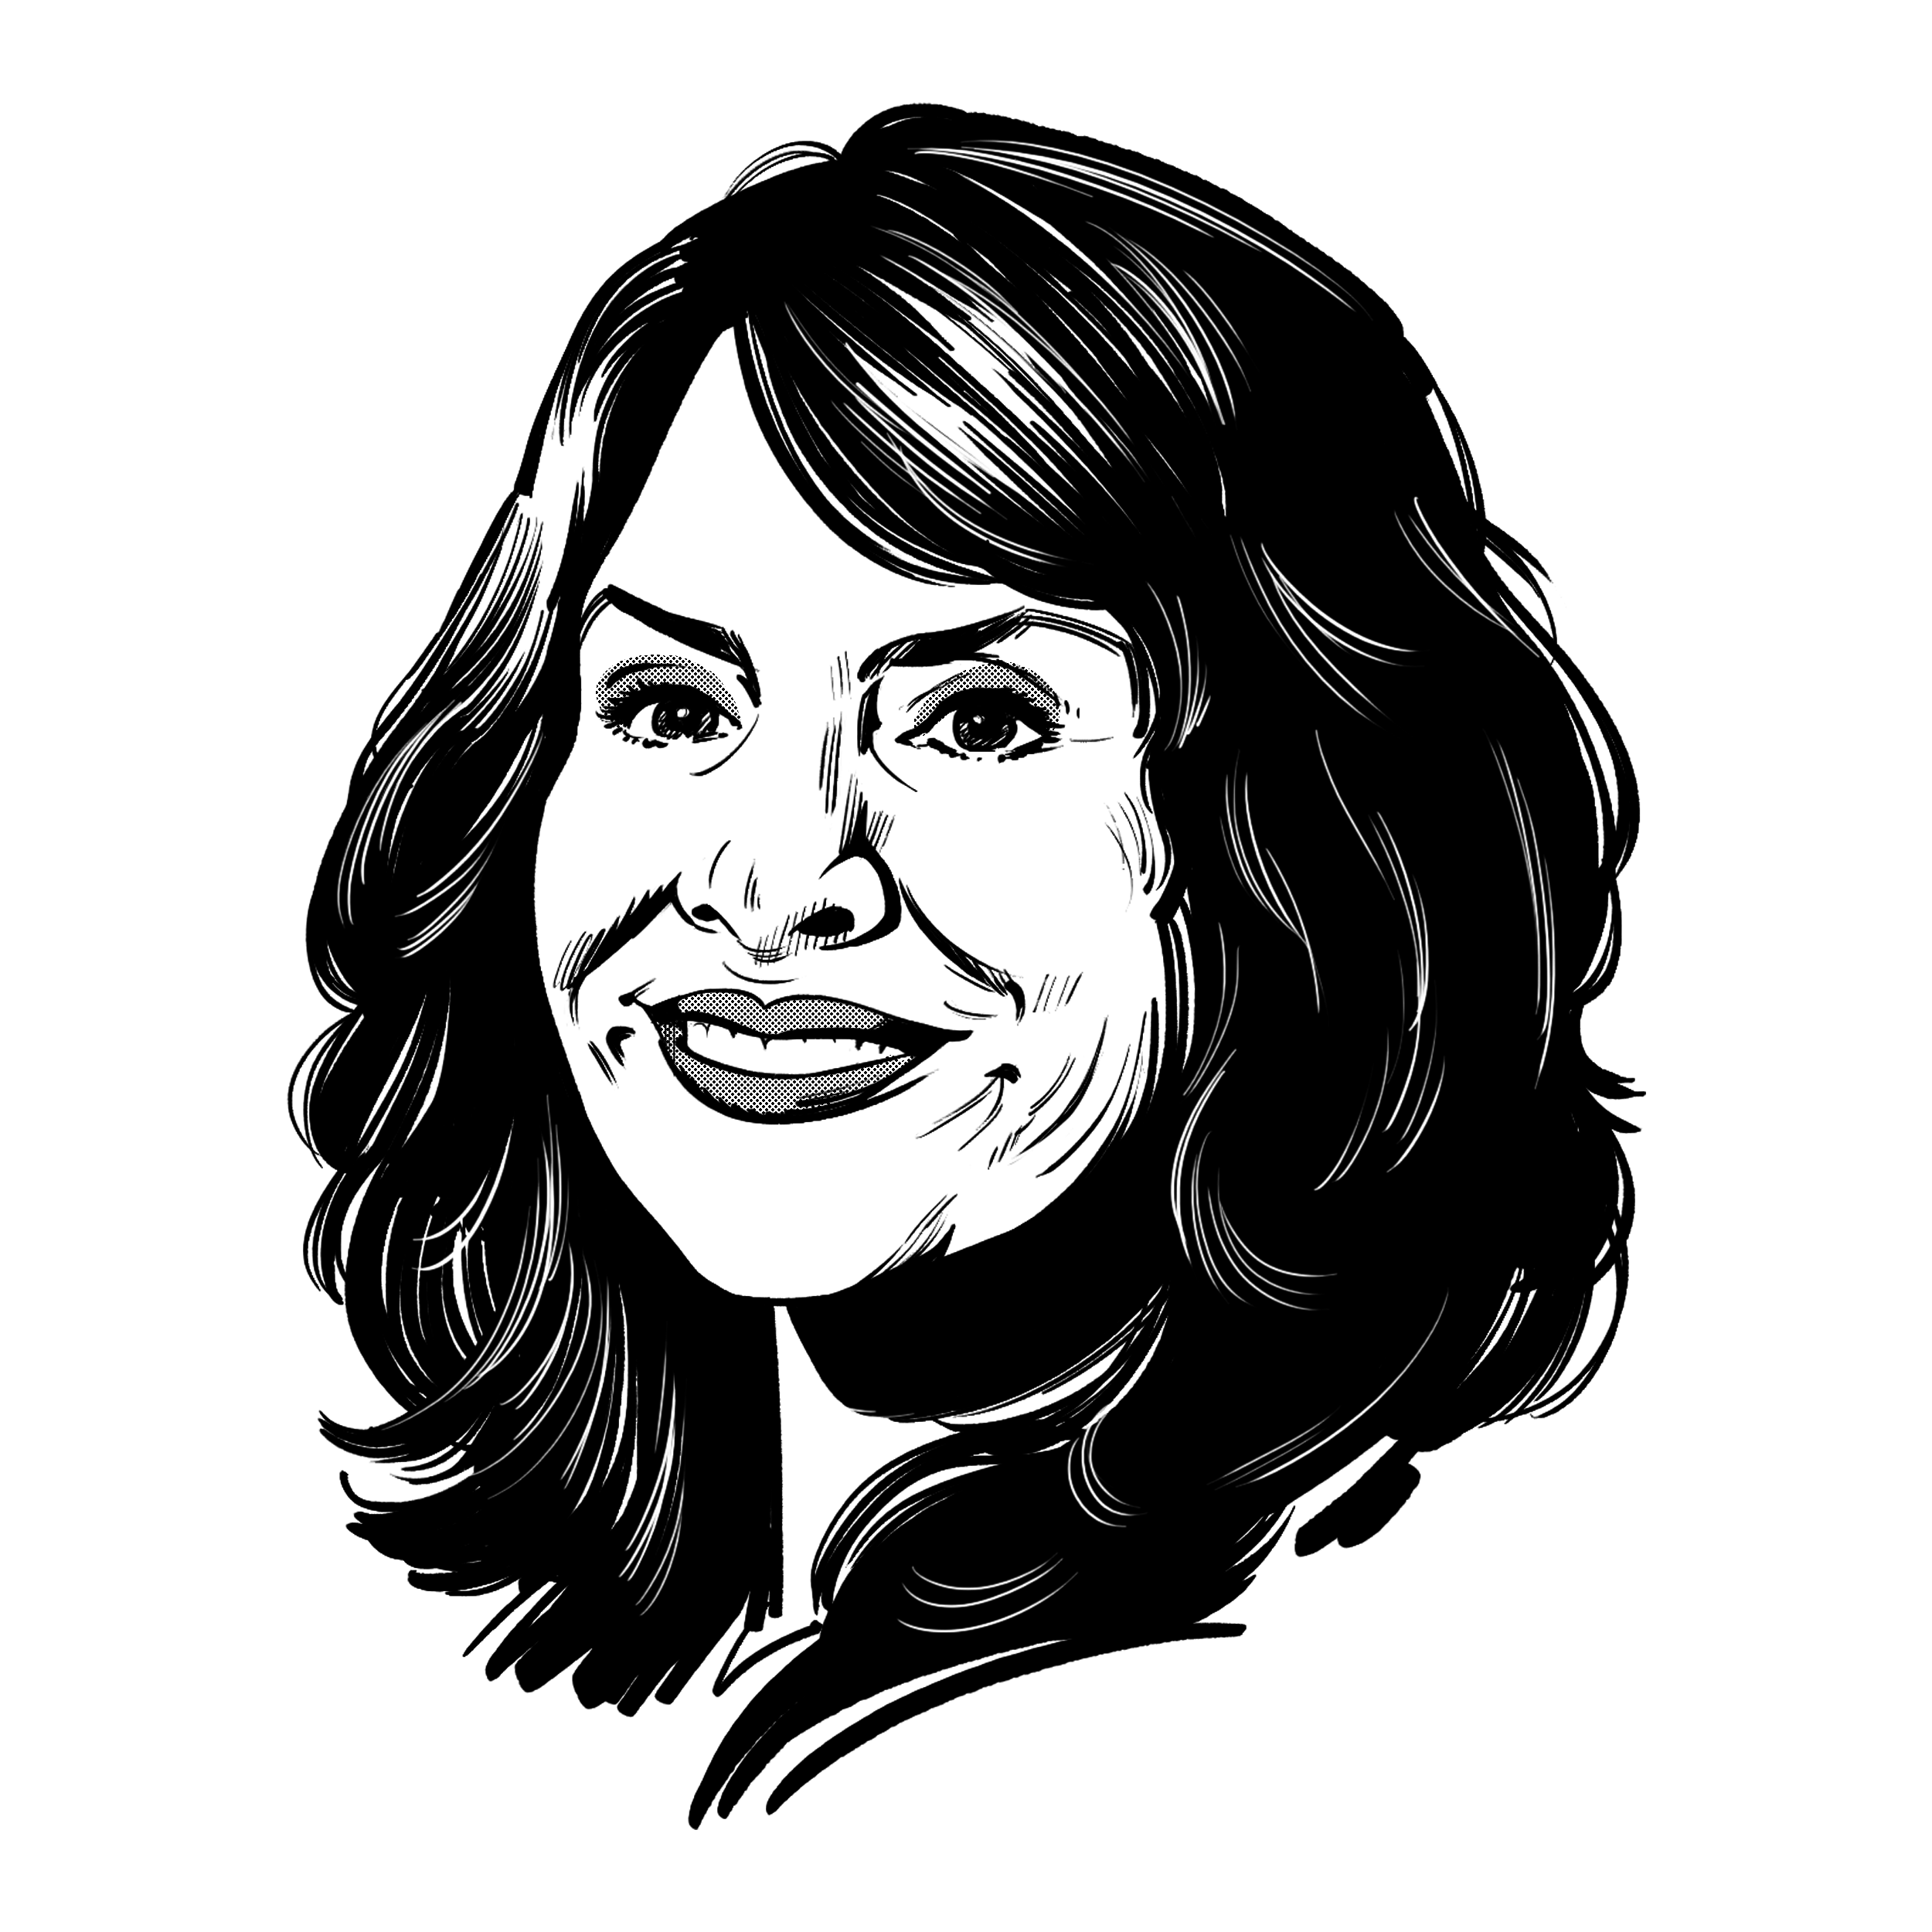
PA
ChaplAins
Conference
Kristi Miller Anderson, PhD

Slide 2
Correctional Staff Wellness:
A Look Within
Overview
Of
Sessions
Correctional Staff Wellness:
A Chaplain’s Role
Desistance Theory: Chaplain as Gateway for Community Prosocial Influences
Desistance Theory: Chaplain as Coach for Prosocial Behaviors / Attitudes

Slide 3
The virtuous prison model
Oxymoron?
Does the prison context make people better, or worse?
How do we create a prison environment where virtue is promoted, and morality is “caught”?

Slide 4
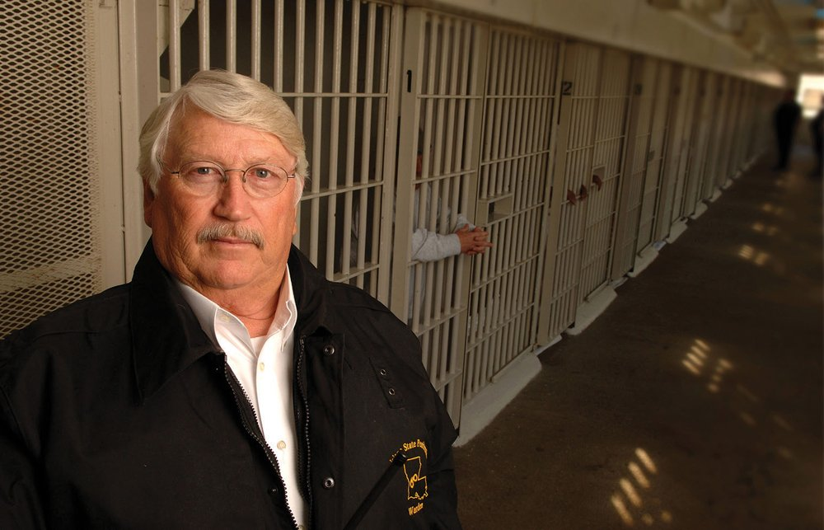
Burl Cain and Angola prison. Warden from 1995-2016. How Angola, once known as “the bloodiest prison in America” became one of the safest and most innovative prisons. It started with a simple question, “How do I infuse morality into the inmates?”
The angola story

Slide 5
Prison Seminary Model
More than just education. According to the research, the key ingredient was found in the “self-projects”.
Indigenous work.
The culture changed from within.

Slide 6
Evidence -based research
Michael Hallet. “First Stop Dying: Angola’s Christian Seminary as Positive Criminology” International Journal of Offender Therapy and Comparative Criminology 1-19, 2015.
Michael Hallett, Joshua Hays, Byron Johnson, Sung Joon Jang, and Grant Duwe. The Angola Prison Seminary: Effects of Faith-Based Ministry on Identity Transformation, Desistance, and Rehabilitation. Angola research. New York: Routledge, 2017.
Byron Johnson, Michael Hallet, and Sung Joon Jang. The Restorative Prison: Essays on Inmate Peer Ministry and Prosocial Corrections. New York: Routledge, 2021.

Slide 7
Self Projects: Practicing Virtue
The Baylor study demonstrates how inmates, once coming to a place of wholeness and healing through the investment of the seminary program, then began creating authentic, healthy, family-type environments for their peers and healing began to take place.
An overall moral change in the prison followed, even improving the inmate/staff relationships.

Slide 8
Who best can speak to the wounds common among the inmate population?
Wounded Healers
How can we encourage our inmate population to begin to care for each other?
Who are the people of peace among our prison population?
Difference between short-term vs long-term sentences.

Slide 9
Some ways peer leaders are used
Pastors
Grief groups
Recovery groups; full 90 day treatment camp
Academic tutors
Vocational tutors
Parenting groups
Hospice care
Suicide watch ministry; dorm ministry

Slide 10
A-Team of Chaplains in the Mississippi DOC

Slide 11
Growing in acceptance
Peer Mentors
It comes with risks; there will be failures
Chaplains are best suited to see those who set themselves apart, who exhibits a servant’s heart
Opportunities to invest in these leaders? Opportunities to advocate? Opportunities to partner with volunteer leaders or outside institutions.

Slide 12
Desistance theory
Primary
Behavior
Secondary
Identity
Tertiary
Belonging
The cessation of offending
The adoption of non-offending identity
The recognition by others that one has changed, along with a sense of belonging

Slide 13
We want to see our inmates become as good citizens; givers and community builders.
Desistance Theory
How can they practice the new attitudes and values of a new identity?
Where can they begin to build prosocial relationships and practice prosocial activities even while incarcerated?
Where can they begin to experience the reward of altruism? Where can they begin to walk in their calling and giftedness?

Slide 14
Where do I fit in?
Isn’t that the question of everyone in this ecosystem?
If not the chaplain, then who will say to both staff and inmates: you are loved, your life matters, and mercies are made new every morning?

Slide 15
Correctional Staff Wellness:
A Look Within
Overview
Of
Sessions
Correctional Staff Wellness:
A Chaplain’s Role
Desistance Theory: Chaplain as Gateway for Community Prosocial Influences
Desistance Theory: Chaplain as Coach for Prosocial Behaviors / Attitudes

Slide 16
The last Word
The Talmud
Do not be daunted by the enormity of the world’s grief. Do justly now. Love mercy now. Walk humbly now. You are not obligated to complete the work, but neither are you free to abandon it.
Ecclesiastes 3:12-13
I know that there is nothing better for men than to be happy and do good while they live. That everyone may eat and drink and find satisfaction in all his toil – this is the gift of God.

Slide 17
Thank you!
kristimilleranderson@gmail.com
225.439.0019
Kristi Miller Anderson, PhD

